Slide 1
Aspects related to Data access and Transfer in cuda
Dan Negrut, Radu Serban, Ang Li, Andrew Seidl
Simulation-Based Engineering Lab
University of Wisconsin-Madison
©2014
Simulation-Based Engineering Lab
University of Wisconsin-Madison

Slide 2
Summary / Objective
Premise: Managing and optimizing host-device data transfers has been challenging
Key point: Unified Memory (UM) support in CUDA 6 simplifies the programmer’s job
The presentation’s two goals:
Briefly review history of CUDA host/device memory management
Explain how UM makes host/device memory management easier and more efficient
Notes:
SR: New slide – just give them a heads up of what to expect

Slide 3
cudaMemcpy
A staple of CUDA, available in release 1.0
Setup was simple: one CPU thread dealt with one GPU
The drill :
Data transferred from host memory into device memory with cudaMemcpy
Data was processed on the device by invoking a kernel
Results transferred from device memory into host memory with cudaMemcpy
Memory allocated on the host with malloc
Memory allocated on the device using the CUDA runtime function cudaMalloc
The bottleneck: data movement over the PCI-E pipe

Slide 4
The PCI-E Pipe, Putting Things in Perspective
PCI-E
V1: 3 GB/s (per direction)
V2: 6 GB/s
V3 (today): 12 GB/s
Bandwidths above pretty small, see for instance
Host memory bus (25 – 51.2 GB/s per socket)
GMEM bandwidth 100 – 200 GB/s
Notes:
(now, Haswell is higher?)

Slide 5
cudaHostAlloc: A friend, with its pluses and minuses
Host/Device data transfer speeds could be improved if host memory was not pageable
Rather than allocating with malloc, host memory was allocated using CUDA’s cudaHostAlloc()
No magic on the hardware side, data still moves back-and-forth through same PCI-E pipe
cudaHostAlloc cons
cudaHostAlloc-ing large amounts of memory can negatively impact overall system performance
Why? It reduces the amount of system memory available for paging
How much is too much? Not clear, dependent on the system and the applications running on the machine
cudaHostAlloc is slow - ballpark 5 GB/s
Allocating 5 GB of memory is timewise comparable to moving that much memory over the PCI-E bus

Slide 6
Key Benefits, cudaHostAlloc-ing Memory
Three benefits to replacing host malloc call with CUDA cudaHostAlloc call
Enables faster device/host back-and-forth transfers
Enables the use of asynchronous memory transfer and kernel execution
Draws on the concept of CUDA stream, a topic not covered here
Enables the mapping of the pinned memory into the memory space of the device
Device now capable to access data on host while executing a kernel or other device function
Focus next is on 3 above

Slide 7
Zero-Copy (Z-C) GPU-CPU Interaction
Last argument (“flag”) controls the magic:
cudaError_t cudaHostAlloc ( void** pHost, size_t size, unsigned int flag)
“flag” values: cudaHostAllocPortable, cudaHostAllocWriteCombined, etc.
The “flag” of most interest is “cudaHostAllocMapped”
Maps the memory allocated on the host in the memory space of the device for direct access
What’s gained:
The ability to access a piece of data from pinned and mapped host memory by a thread running on the GPU without a CUDA runtime copy call to explicitly move data onto the GPU
This is called zero-copy GPU-CPU interaction, from where the name “zero-copy memory”
Note that data is still moved through the PCI-E pipe, but it’s done in a transparent fashion

Slide 8
Z-C, Further Comments
More on the “flag” argument, which can take four values:
Use cudaHostAllocDefault argument for getting plain vanilla pinned host memory (call becomes identical in this case to cudaMallocHost call)
Use cudaHostAllocMapped to pick up the Z-C functionality
See documentation for cudaHostAllocWriteCombined the cudaHostAllocPortable
These two flags provide additional tweaks, irrelevant here
The focus should not be on cudaHostAlloc() and the “flag”
This function call is only a means to an end
Focus should be on the fact that a device thread can directly access host memory

Slide 9
From Z-C to UVA: CUDA 2.2 to CUDA 4.0
Z-C enabled access of data on the host from the device required one additional runtime call to cudaHostGetDevicePointer()
cudaHostGetDevicePointer(): given a pointer to pinned host memory produces a new pointer that can be invoked within the kernel to access data stored on the host
The need for the cudaHostGetDevicePointer() call eliminated in CUDA 4.0 with the introduction of the Unified Virtual Addressing (UVA) mechanism

Slide 10
Unified Virtual Addressing: CUDA 4.0
CUDA runtime can identify where the data is stored based on the value of the pointer
Possible since one address space was used for all CPU and GPU memory
In a unified virtual address space setup, the runtime manipulates the pointer and allocation mappings used in device code (through cudaMalloc) as well as pointers and allocation mappings used in host code (through cudaHostAlloc()) inside a single unified space

Slide 11
UVA - Consequences
There is no need to deal with cudaMemcpyHostToHost, cudaMemcpyHostToDevice, cudaMemcpyDeviceToHost, and cudaMemcpyDeviceToDevice scenarios
Simply use the generic cudaMemcpyDefault flag
Technicalities regarding the need to call cudaGetDeviceProperties() for all participating devices (to check cudaDeviceProp::unifiedAddressing flag) to figure out whether they’re game for UVA are skipped
What this buys us: ability to do, for instance, inter-device copy that does not rely on the host for staging data movement:
cudaMemcpy(gpuDst_memPntr, gpuSrc_memPntr, byteSize, cudaMemcpyDefault)

Slide 12
UVA – Showcasing Its Versatility…
Set of commands below can be issued by one host thread to multiple devices
No need to use anything beyond cudaMemcpyDefault
cudaMemcpy(gpu1Dst_memPntr, host_memPntr, byteSize1, cudaMemcpyDefault)
cudaMemcpy(gpu2Dst_memPntr, host_memPntr, byteSize2, cudaMemcpyDefault)
cudaMemcpy(host_memPntr, gpu1Dst_memPntr, byteSize1, cudaMemcpyDefault)
cudaMemcpy(host_memPntr, gpu2Dst_memPntr, byteSize2, cudaMemcpyDefault)
UVA support is the enabler for the peer-to-peer (P2P), inter-GPU, data transfer
P2P not topic of discussion here
UVA is the underpinning technology for P2P
Notes:
SR: I don’t follow this? A single thread could have done this before. With our without cudaMemcpyHostToDevice (etc.)

Slide 13
UVA is a Step Forward Relative to Z-C
Z-C Key Accomplishment: use pointer within device function access host data
Z-C focused on a data access issue relevant in the context of functions executed on the device
UVA had a data access component but also a data transfer component:
Data access: A GPU could access data on a different GPU, a novelty back in CUDA 4.0
Data transfer: copy data in between GPUs
cudaMemcpy is the main character in this play, data transfer initiated on the host side

Slide 14
Zero-Copy, UVA, and How UM Fits In
Both for Z-C and UVA the memory was allocated on the device w/ cudaMalloc and on the host with cudaHostAlloc
The magic ensued upon the cudaHostAlloc/cudaMalloc duo
Examples of things that can be done:
Data on host accessed on the device
Data transferred effectively in between devices without intermediate staging on the host
Data stored by one GPU accessed directly by a different GPU
Etc.

Slide 15
Zero-Copy, UVA, and How UM Fits In
Unified Memory (UM) eliminates the need to call the cudaMalloc/cudaHostAlloc duo
It takes a different perspective on handling memory in the GPU/CPU interplay
Note that in theory one could get by using Z-C and only calling cudaHostAlloc once. This is not recommended when having repeated accesses by device to host-side memory
Each device request that ends up accessing the host-side memory incurs high latency and low bandwidth (relative to the latency and bandwidth of an access to device global memory)
This is the backdrop against which the role of UM is justified
Data is stored and migrated in a user-transparent fashion
To the extent possible, the data is right where it’s needed thus enabling fast access

Slide 16
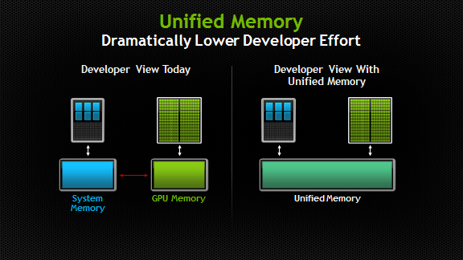
Unified Memory (UM)
One memory allocation call takes care of memory setup at both ends; i.e., device and host
The main actor: the CUDA runtime function cudaMallocManaged()
New way of perceiving the memory interplay in GPGPU computing
No distinction is made between memory on the host and memory on the device
It’s just memory, albeit with different access times when accessed by different processors
Old Memory Perception
New Perception with Unified Memory
[NVIDIA]→

Slide 17
Unified Memory (UM) – Semantics Issues [clarifications of terms used on previous slide]
“processor” (from NVIDIA documentation): any independent execution unit with a dedicated memory management unit (MMU)
Includes both CPUs and GPUs of any type and architecture
“different access time”: time is higher when, for instance, the host accesses for the first time data stored on the device.
Subsequent accesses to the same data take place at the bandwidth and latency of accessing host memory
This is why access time is different and lower
Original access time higher due to migration of data from device to host
NOTE: same remarks apply to accesses from the device
[NVIDIA]→

Slide 18
Now and Then: UM, no-UM
#include <iostream>
#include "math.h"
const int ARRAY_SIZE = 1000;
using namespace std;
__global__ void increment(double* aArray, double val, unsigned int sz){
unsigned int indx = blockIdx.x * blockDim.x + threadIdx.x;
if (indx < sz)
aArray[indx] += val;
}
int main(int argc, char **argv) {
double* hA;
double* dA;
hA = (double *)malloc(ARRAY_SIZE * sizeof(double));
cudaMalloc(&dA, ARRAY_SIZE * sizeof(double));
for (int i = 0; i < ARRAY_SIZE; i++)
hA[i] = 1.*i;
double inc_val = 2.0;
cudaMemcpy(dA, hA, sizeof(double) * ARRAY_SIZE, cudaMemcpyHostToDevice);
increment <<<2, 512 >>>(dA, inc_val, ARRAY_SIZE);
cudaMemcpy(hA, dA, sizeof(double) * ARRAY_SIZE, cudaMemcpyDeviceToHost);
double error = 0.;
for (int i = 0; i < ARRAY_SIZE; i++)
error += fabs(hA[i] - (i + inc_val));
cout << "Test: " << (error < 1.E-9 ? "Passed" : "Failed") << endl;
cudaFree(dA);
free(hA);
return 0;
}
#include <iostream>
#include "math.h"
const int ARRAY_SIZE = 1000;
using namespace std;
__global__ void increment(double* aArray, double val, unsigned int sz) {
unsigned int indx = blockIdx.x * blockDim.x + threadIdx.x;
if (indx < sz)
aArray[indx] += val;
}
int main(int argc, char **argv) {
double* mA;
cudaMallocManaged(&mA, ARRAY_SIZE * sizeof(double));
for (int i = 0; i < ARRAY_SIZE; i++)
mA[i] = 1.*i;
double inc_val = 2.0;
increment <<<2, 512 >>>(mA, inc_val, ARRAY_SIZE);
cudaDeviceSynchronize();
double error = 0.;
for (int i = 0; i < ARRAY_SIZE; i++)
error += fabs(mA[i] - (i + inc_val));
cout << "Test: " << (error < 1.E-9 ? "Passed" : "Failed") << endl;
cudaFree(mA);
return 0;
}

Slide 19
UM vs. Z-C
Recall that with Z-C, data is always on the host in pinned CPU system memory
The device reaches out to it
UM: data stored on the device but made available where needed
Data access and locality managed by underlying system, handling transparent to the user
UM provides “single-pointer-to-data” model
Support for UM called for only *three* additions to CUDA:
cudaMallocManaged, __managed__ , cudaStreamAttachMemAsync()

Slide 20
Technicalities…
cudaError_t cudaMallocManaged ( void** devPtr, size_t size, unsigned int flag)
Returns pointer accessible from both Host and Device
Drop-in replacement for cudaMalloc() – they are semantically similar
Allocates managed memory on the device
First two arguments have the expected meaning
“flag” controls the default stream association for this allocation
cudaMemAttachGlobal - memory is accessible from any stream on any device
cudaMemAttachHost – memory on this device accessible by host only
Free memory with the same cudaFree()
__managed__
Global/file-scope variable annotation combines with __device__
Declares global-scope migrateable device variable
Symbol accessible from both GPU and CPU code
cudaStreamAttachMemAsync()
Manages concurrency in multi-threaded CPU applications

Slide 21
UM, Quick Points
In the current implementation, managed memory is allocated on the device that happens to be active at the time of the allocation
Managed memory is interoperable and interchangeable with device-specific allocations, such as those created using the cudaMalloc() routine
All CUDA operations that are valid on device memory are also valid on managed memory

Slide 22
Example: UM and thrust
#include <ostream>
#include <cmath>
#include <thrust/reduce.h>
#include <thrust/system/cuda/execution_policy.h>
#include <thrust/system/omp/execution_policy.h>
const int ARRAY_SIZE = 1000;
int main(int argc, char **argv) {
double* mA;
cudaMallocManaged(&mA, ARRAY_SIZE * sizeof(double));
thrust::sequence(mA, mA + ARRAY_SIZE, 1);
double maximumGPU = thrust::reduce(thrust::cuda::par, mA, mA + ARRAY_SIZE, 0.0, thrust::maximum<double>());
cudaDeviceSynchronize();
double maximumCPU = thrust::reduce(thrust::omp::par , mA, mA + ARRAY_SIZE, 0.0, thrust::maximum<double>());
std::cout << "GPU reduce: “ << (std::fabs(maximumGPU - ARRAY_SIZE) < 1e-10 ? "Passed" : "Failed") << std::endl;
std::cout << "CPU reduce: “ << (std::fabs(maximumCPU - ARRAY_SIZE) < 1e-10 ? "Passed" : "Failed") << std::endl;
cudaFree(mA);
return 0;
}

Slide 23
Advanced Features: UM
Managed memory migration is at the page level
The default page size is currently the same as the OS page size today (typically 4 KB)
The runtime intercepts CPU dirty pages and detects page faults
Moves from device over PCI-E only the dirty pages
Transparently, pages touched by the CPU (GPU) are moved back to the device (host) when needed
Coherence points are kernel launch and device/stream sync.
Important: the same memory cannot be operated upon, at the same time, by the device and host
Notes:
A lot of this picked up from http://devblogs.nvidia.com/parallelforall/unified-memory-in-cuda-6/

Slide 24
Advanced Features: UM
Issues related to “managed memory size”:
For now, there is no oversubscription of the device memory
In fact, if there are several devices available, the max amount of managed memory that can be allocated is the smallest of the memories available on the devices
Issues related to “transfer/execution overlap”:
Pages from managed allocations touched by CPU migrated back to GPU before any kernel launch
Consequence: there is no kernel execution/data transfer overlap in that stream
Overlap possible with UM but just like before it requires multiple kernels in separate streams
Enabled by the fact that a managed allocation can be specific to a stream
Allows one to control which allocations are synchronized on specific kernel launches, enables concurrency
Notes:
A lot of this picked up from http://devblogs.nvidia.com/parallelforall/unified-memory-in-cuda-6/

Slide 25
UM: Coherency Related Issues
The GPU has *exclusive* access to this memory when any kernel is executed on the device
Holds even if the kernel doesn’t touch the managed memory
The CPU cannot access *any* managed memory allocation or variable as long as GPU is executing
A cudaDeviceSynchronize() call required for the host to be allowed to access managed memory
To this end, any function that logically guarantees the GPU finished execution is acceptable
Examples: cudaStreanSynchronize(), cudaMemcpy(), cudaMemset(), etc.

Slide 26
Left: Seg fault Right: Runs ok
__device__ __managed__ int x, y = 2;
__global__ void kernel() {
x = 10;
}
int main() {
kernel << < 1, 1 >> >();
y = 20; // ERROR: CPU access concurrent with GPU
cudaDeviceSynchronize();
return 0;
}
__device__ __managed__ int x, y = 2;
__global__ void kernel() {
x = 10;
}
int main() {
kernel << < 1, 1 >> >();
cudaDeviceSynchronize();
y = 20; // GPU is idle so access is OK
return 0;
}
[NVIDIA, Programming Guide]→

Slide 27
UM – Current Limitations in CUDA 6.0
Ability to allocate more memory than the physically available on the GPU
Prefetching
Finer Grain Migration

Slide 28
UM – Why Bother?
A matter of convenience
Much simpler to write code using this memory model
For the casual programmer, the code will run faster due to data locality
The runtime will take care of moving the data where it ought to be
Looking ahead, physical CPU/GPU integration around the corner – memory will be shared
Already the case for integrated GPUs that are part of the system chipset
The trend in which the industry is moving (AMD’s APU, Intel’s Haswell, NVIDIA Denver Project)
The functionality provided by the current software backend that supports the cudaMallocManaged() paradigm will be eventually implemented in hardware

Slide 29
CUDA 6.0 At Work
Sparse Matrix Reordering for LU Factorization on the GPU

Slide 30
Sparse Linear Algebra on the GPU
Problem Statement:
Solve Ax=b, where A is large and sparse
Solutions for parallel execution already exist…
In cusparse if A is symmetric and positive definite
Using MPI or OpenMP
Ongoing work on general purpose preconditioner using a partitioning of the problem into subproblems that are solved in parallel
Approach known in the literature as SPIKE
GitHub repo: https://github.com/spikegpu/SpikeLibrary
Project webpage: http://spikegpu.sbel.org/
Focus herein on the performance of CUDA 6.0 in the context of sparse matrix reordering

Slide 31
Introduction, Matrix Reordering For Diagonal Dominance
Non-symmetric reordering approach – moves around entries in a matrix by shifting the order of the rows and columns in the matrix
What’s desired: migrate to the diagonal the matrix elements whose absolute value is large
Why? Helps achieving a high degree of diagonal dominance
Decreases probability of encountering a zero pivot during the LU factorization of the sparse matrix
Improve the quality of the LU factorization
Core part of algorithm: finding minimum perfect bipartite matching

Slide 32
Matrix Reordering Algorithm: Four Stages
First stage: forming bipartite graph
View each row as a row node and each column as a column node. There is an edge between each pair of row node and column node.
An edge has finite weight if and only if the matrix has a non-zero value in the corresponding entry.
Given a matrix, the structure of matrix is unchanged, only values need to be processed to get the weights of the bipartite graph
Can be done in parallel on the GPU
Second stage: finding initial partial match (optional)
For each column node j, find a row node i so that edge (i, j) is the minimum over all edges connected to column node j.
If row node i is not yet matched to another column node, match i to j
Hard to do on the GPU

Slide 33
Stages of the Algorithm (Cont’d)
Third stage: finding a perfect match
If in the second stage all column nodes are matched, then this stage is not necessary
Apply Hungarian algorithm (i.e. finding augmenting path) to match each unmatched column node
Report error if Hungarian algorithm fails to find a match with finite value for a certain node
Totally sequential in nature, no good parallel algorithm suitable for GPU as of now
Fourth stage: extracting the permutation and the scaling factors
Permutation can be obtained directly form the resulting perfect match
Stage is highly parallelizable and suitable for GPU computing

Slide 34
Sparse Matrix Reordering Strategy
Stages 1 and 4 done on the GPU
Stages 2 and 3 done on the CPU
Use of UM:
Store all data required to perform matrix reordering in managed memory
The GPU accesses data stored in managed memory during stage 1 and 4
The CPU accesses data stored in managed memory during stage 2 and 3
Goals:
Simplify code
Don’t hurt performance

Slide 35
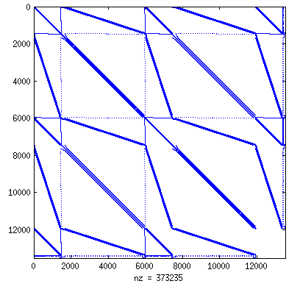
Matrix Reordering Example [Part 1/3]: Sparsity Pattern of Original Matrix
Garon2: sparse matrix from Florida collection
Dimension of the sparse matrix
N = 13535
Number of nonzero entries in the matrix
NNZ = 373235
Half bandwidth of the matrix
K_ori= 13531

Slide 36
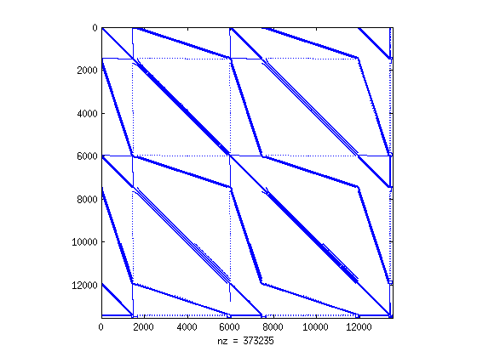
Matrix Reordering Example [Part 2/3]: Sparsity Pattern after the four-stage reordering
This is the algorithm of interest, gauge overhead associated with use of UM
Timing results are presented shortly
Half bandwidth after reordering:
K_4s = 13531
Bandwidth still large, but all diagonal entries are nonzero and large in magnitude

Slide 37
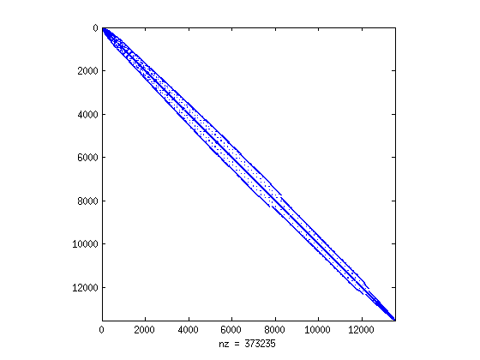
Matrix Reordering Example [Part 3/3]: Sparsity Pattern after reverse Cuthill-Mckee (RCM)
All non-zeros of the matrix now close to the diagonal
Small half bandwidth:
K_RCM = 585
This matrix is passed to the SPIKE::GPU preconditioner to produce an LU factorization
GPU LU factorization details not discussed here

Slide 38
The Key Slide: Performance Comparison
Ran more than 120 sparse matrix reordering tests
Ranked from the best to the worst CUDA 6 performance
Took every tenth matrix in this ranking, see table
Times reported were measured in milliseconds
Time that it takes to get the matrix with K_4s
Bottom line: using UM and letting the runtime take care of business never resulted in more than a 25% slowdown over hand-tuned code
Almost half of the tests ran faster
See “Speedup” column, which reports nominal time divided by time using UM in CUDA 6
Name | Dim. | NNZ | Time Basic | Time UM | Speedup
poisson3Db | 85623 | 2374949 | 120.293 | 86.068 | 1.397651
pdb1HYS | 36417 | 4344765 | 153.276 | 128.269 | 1.194957
inline_1 | 503712 | 36816342 | 1299.3 | 1129.12 | 1.150719
qa8fk | 66127 | 1660579 | 62.088 | 55.216 | 1.124457
finan512 | 74752 | 596992 | 29.526 | 29.155 | 1.012725
lhr71 | 70304 | 1528092 | 726.646 | 762.697 | 0.952732
g7jac140 | 41490 | 565956 | 701.929 | 761.265 | 0.922056
ASIC_100k | 99340 | 954163 | 51.512 | 56.924 | 0.904926
gearbox | 153746 | 9080404 | 1257.32 | 1424.52 | 0.882627
rma10 | 46835 | 2374001 | 211.592 | 252.221 | 0.838915
bmw3_2 | 227362 | 11288630 | 741.092 | 911.724 | 0.812847
stomach | 213360 | 3021648 | 174.105 | 226.585 | 0.768387
Notes:
SR: You might want to comment – everything that is done by UM can be done (at great effort) by hand using cudaMemcpy. So what is it about the original algorithm that was sub-optimal such that UM gave a perf boost?
SR: As well, the result is somewhat inconclusive – some are faster some are slower. What is it about UM that caused some of the tests to slow down? How could this be avoided?

Slide 39
Where Else Are We Using CUDA and GPU Computing?
Fluid-solid interaction problems
Many-body dynamics, for rigid or flexible bodies
Example: dynamics granular material

Slide 40
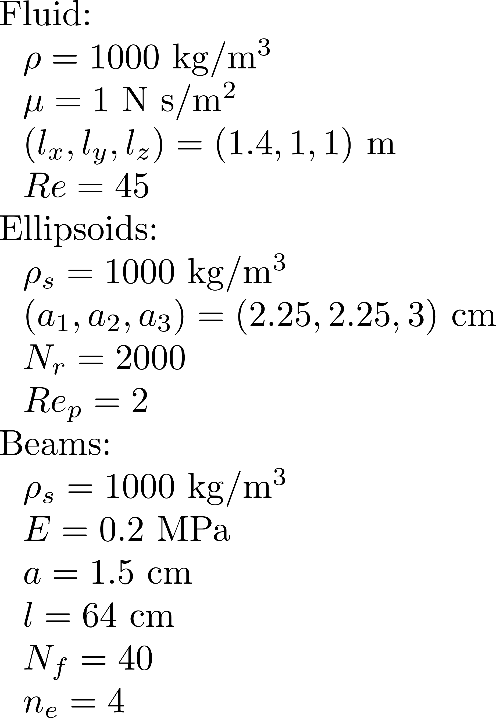
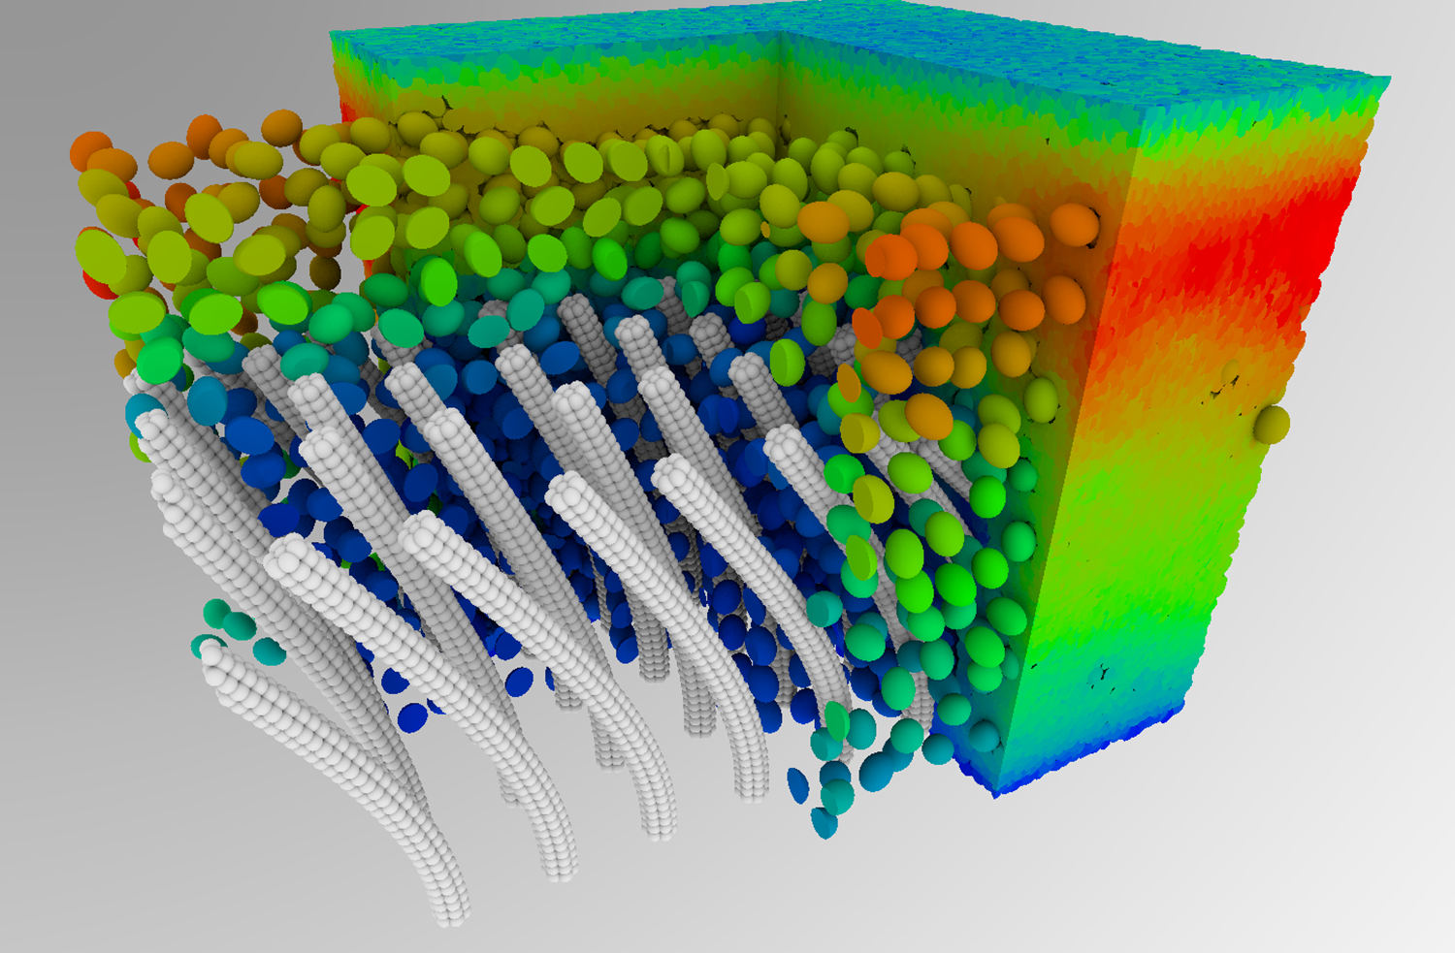
Interacting rigid and flexible objects in channel flow

Slide 41
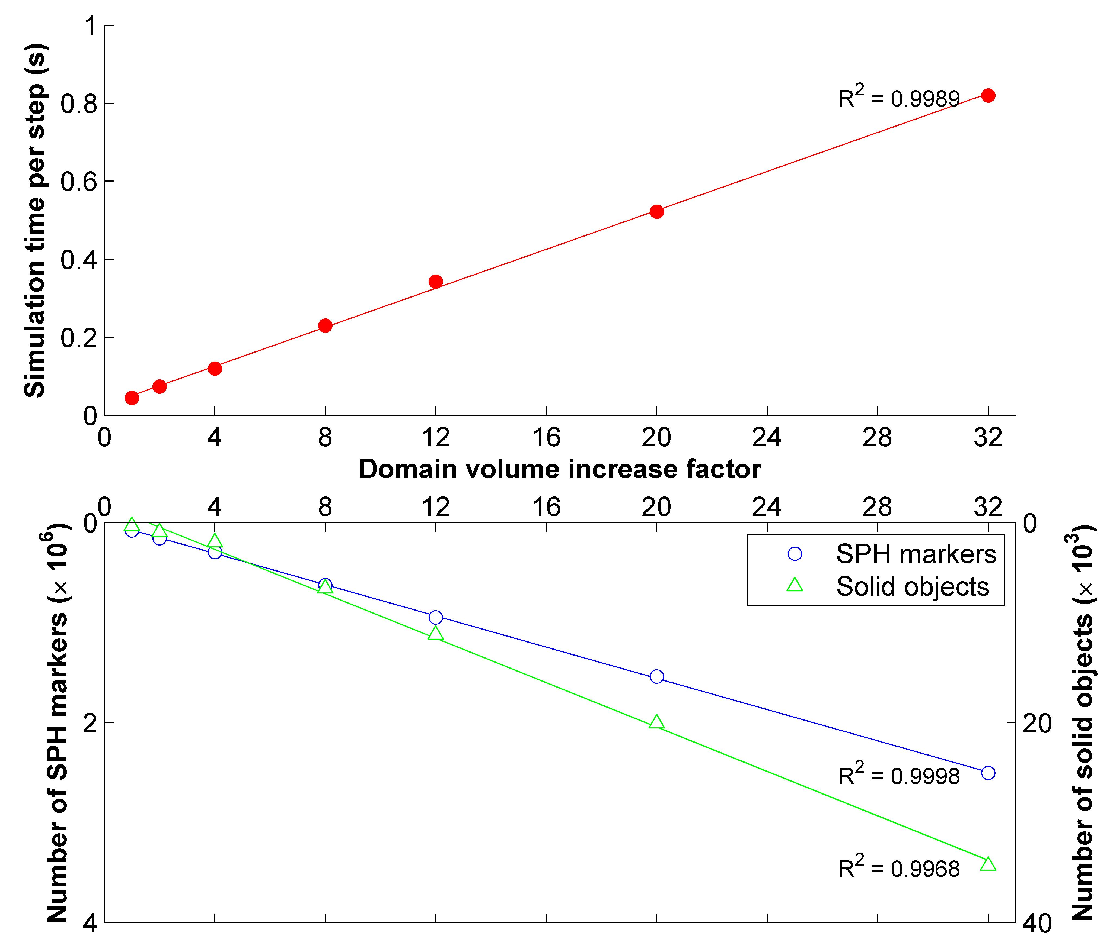
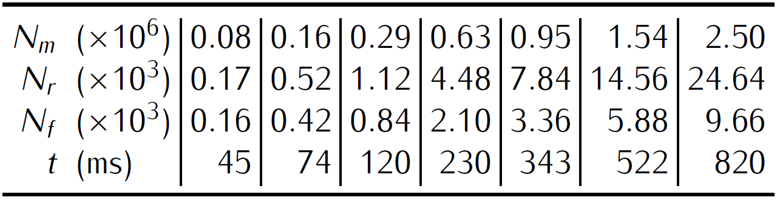
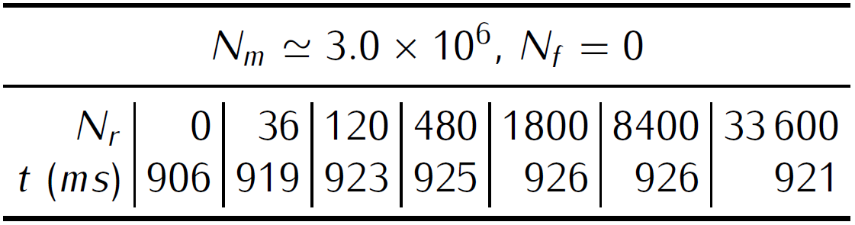
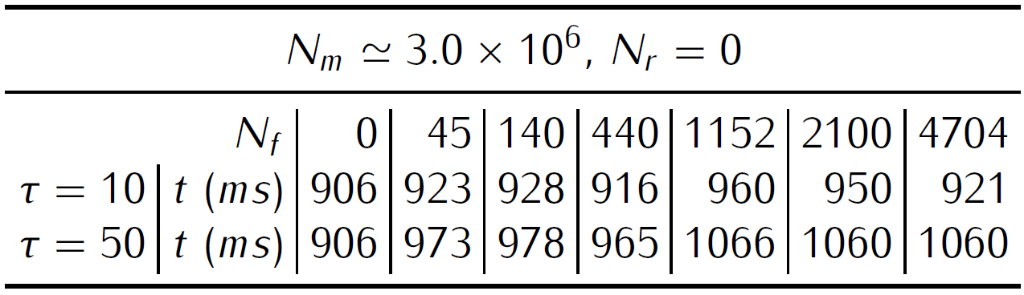
Scaling analysis (all together, table)
Notes:
This shows that when you double the number of bodies and the number of markers you double the amount of compute time
How difficult is to run two more tests:
Keep doubling the number of bodies for the same number of markers (say 2,000,000) to show that the compute time doesn’t change
Keep doubling the number of markers and keep the same number of bodies (say 1000) to show that the compute time goes up
Right-bottom figure: this shows that increasing the number of rigid bodies has only a little effect, if any, on the simulation time.

Slide 42
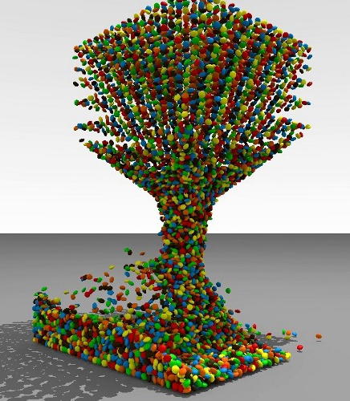
Multibody Dynamics
Simulation parameters
50,000 Ellipsoids
r = [0.26,0.14,0.26] m
mu= 0.5
Step-size: h = 10E-3 s
Simulation time: 2.1 s / step GTX 480

Slide 43
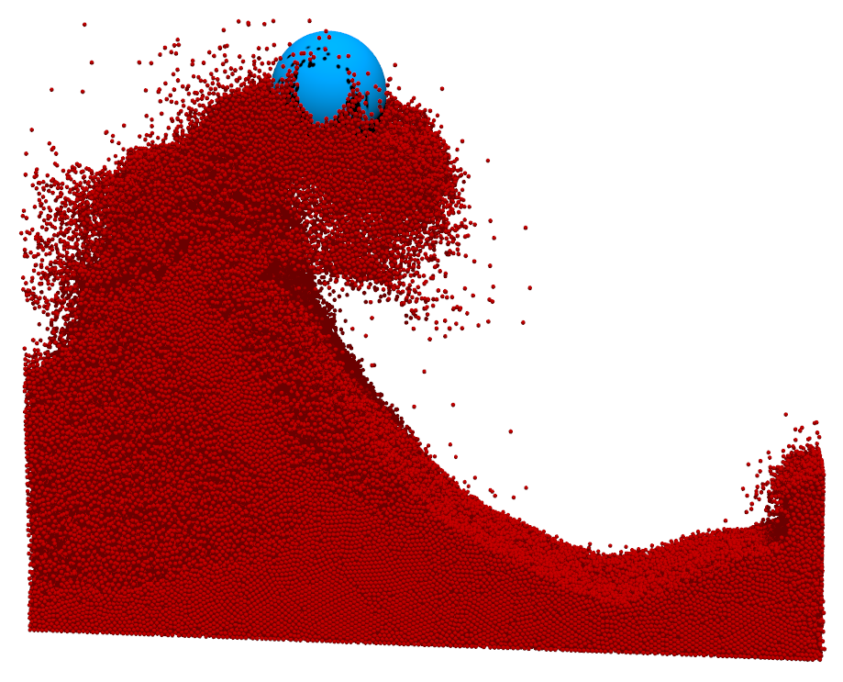
1.1 Million Body on the GPU

Slide 44
Further Reading, Information Pointers
CUDA 6.0 Programming Manual
Mark Harris post: http://devblogs.nvidia.com/parallelforall/unified-memory-in-cuda-6/
Comments are insightful too
Thrust 1.8: https://github.com/thrust/thrust
Interesting posts: http://www.alexstjohn.com/WP/2014/04/28/cuda-6-0-first-look/
Sparse Linear Algebra: https://github.com/spikegpu/
Solve sparse linear systems on the GPU
Reordering for diagonal dominance
Reverse Cuthill-Mckee (RCM) band reduction

Slide 45
Thank You…
Justin Madsen, Steve Rennich, Mark Ebersole
The nice people above helped with suggestions that improved the quality of the document

